Slide 1
QA Quiz TG-218, Low et al.

Slide 2
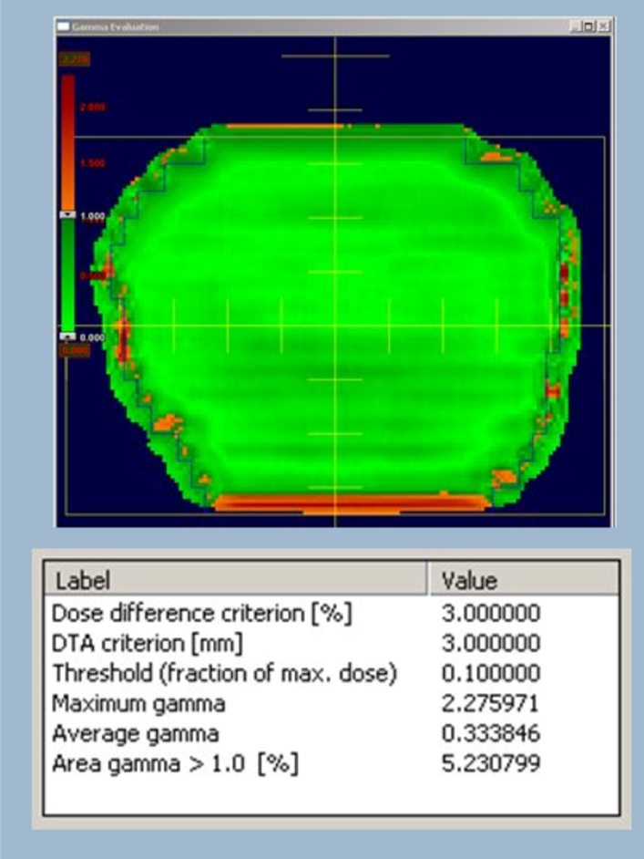
Q1
Would this pass you QA?
What documents could you reference for QA passing criteria?

Slide 3
Q2
Explain the differences between the three QA methods described in TG-218: PFF, PC, TC?
Which method is recommended?
What are the device limitations of this method?
What do you use at your institution?

Slide 4
Q3
What type of normalization is recommended for IMRT QA and why?
Why is a threshold of 10% of the prescription dose recommended?
What is the difference between a tolerance limit and an action limit?
Global normalization should be used. Global normalization is deemed more clinically relevant than local normalization. The global normalization point should be selected whenever possible in a low gradient region with a value that is ≥ 90% of the maximum dose in the plane of measurement. This will provide a more realistic measure of the comparison between the two dose distributions.
Local normalization is more stringent than global normalization for routine IMRT QA. It can be used during the IMRT commissioning process and for troubleshooting IMRT QA.
The dose threshold should be set to exclude low-dose areas that have no or little clinical relevance but can significantly bias the analysis. An example is setting the threshold to 10% in a case where the critical structure dose tolerance exceeds 10% of the prescription dose. This allows the γ passing rate analysis to ignore the large area or volume of dose points that lie in very low-dose regions which, if included, would tend to increase the passing rate when global normalization is used. Universal tolerance limits: the γ passing rate should be ≥ 95%, with 3%/2 mm and a 10% dose threshold.
•Universal action limits: the γ passing rate should be ≥ 90%, with 3%/2 mm and a 10% dose threshold.
○If the plan fails this action limit, evaluate the γ failure distribution and determine if the failed points lie in regions where the dose differences are clinically irrelevant, in which case the plan may be clinically acceptable.

Slide 5
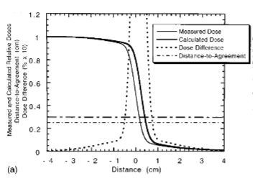
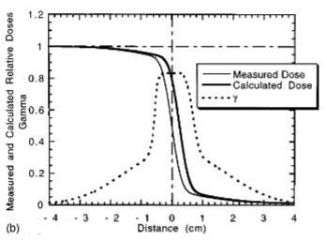
Q4
What is wrong with this measurement?
Would this pass QA?
Describe which regions DTA and dose difference are used and why? The measured and calculated dose distributions for a positionshift of 0.25 cm ~x050.25 cm for the calculated dose distri-bution! are shown in Fig. 4~a!. The dose-difference and DTAare also shown. The dose difference is multiplied by 10 suchthat the position on the graph of the dose-difference criterion~3%! appears at the same location as the criterion for theDTA ~3 mm!. The passing criterion is shown as a thick dot–dashed horizontal line at 0.3.The DTA is a constant 0.25 cm, as expected. The dosedifference rises rapidly at the penumbra, peaking beyond thescope of the graph, with a value of 0.33. Because the DTA isalways less than 0.3 cm, there are no regions that fail thecomposite evaluation
Notes:
Figure 4b shows the measured and calculated dose distributions, and the g index, for the same conditions as in Fig.4a The maximum value of gamma is 0.83, corresponding to the maximum value of the dose difference. The value of g in all regions is less than 1.0, indicating that the calculation passes the acceptance tests, consistent with the composite evaluation Fig. 4a. Dose differences in high dose gradient regions may therefore be relatively unimportant, and the concept of a distance-to-agreement ~DTA! distribution is used to determine the acceptability of the dose calculation. In low gradient regions, the doses are compared directly.

Slide 6
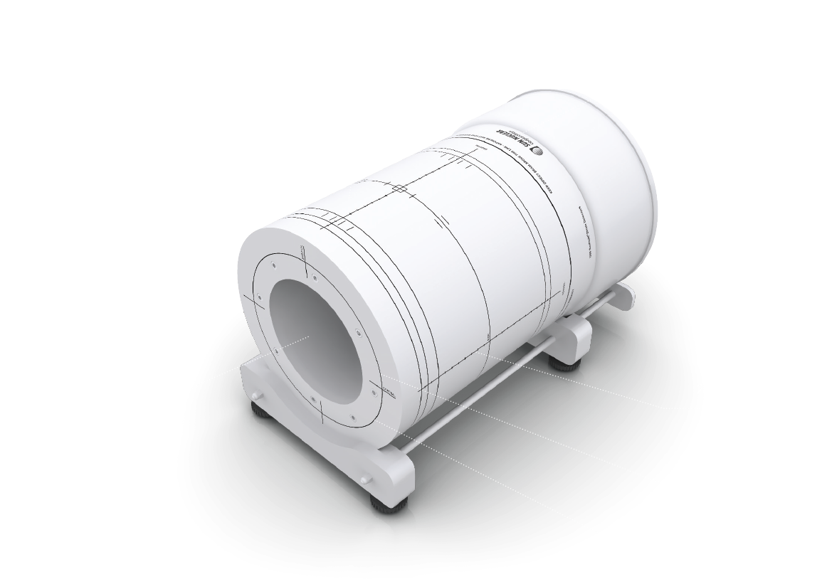
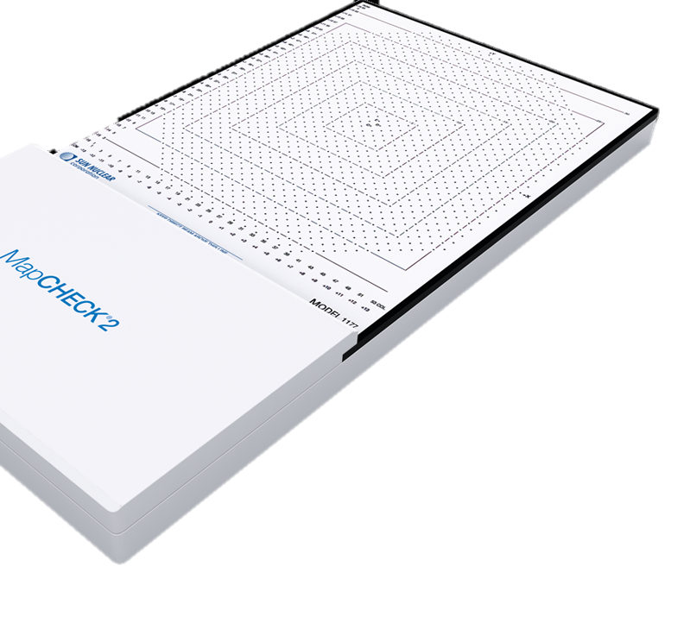
Q5
Describe each device and it’s use in IMRT QA.
Notes:
MapCheck
Detector Array—The MapCHECK 2 has 1,527 diode detectors arranged in a 26 x 32 cm array and indicated by small gray squares and circles. Each row is offset so that the diagonal spacing between detectors is 7.07 mm.
ArcCheck
The diode detectors are arranged in a spiral pattern with 10 mm detector spacing on the cylinder. The ArcCHECK has a total of 21 spiral rings, with 66 diodes at each ring.

